Slide 1
The Online Assignment Calculator:
Scaffolding Information Literacy Skills at the Austin Community College Eastview Campus

Slide 2
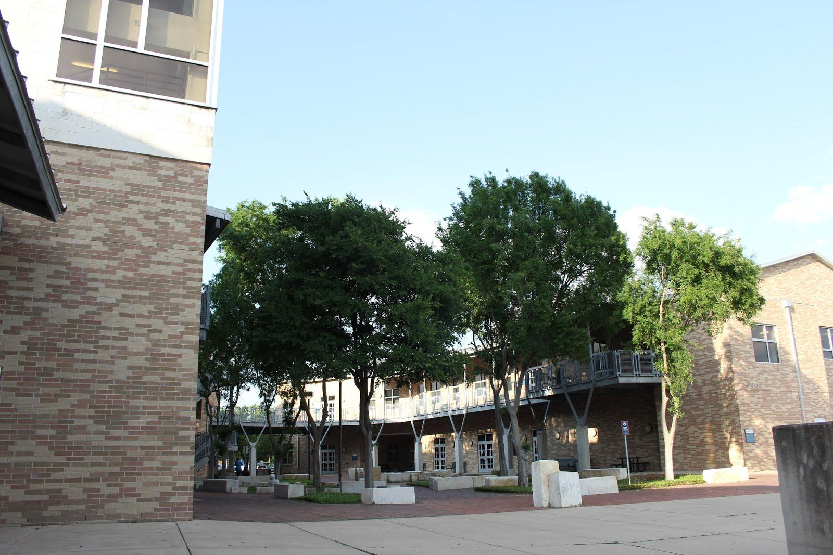
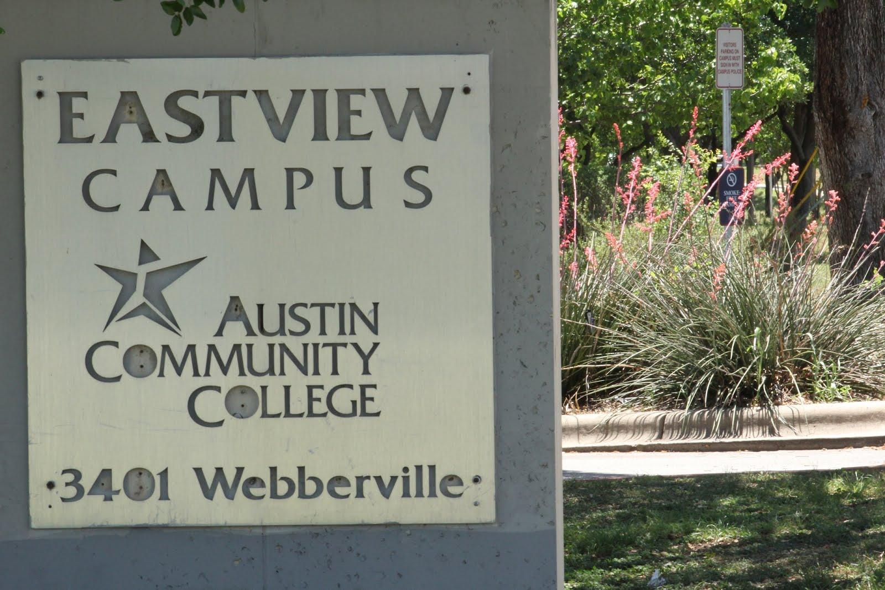
Setting: ACC Eastview

Slide 3
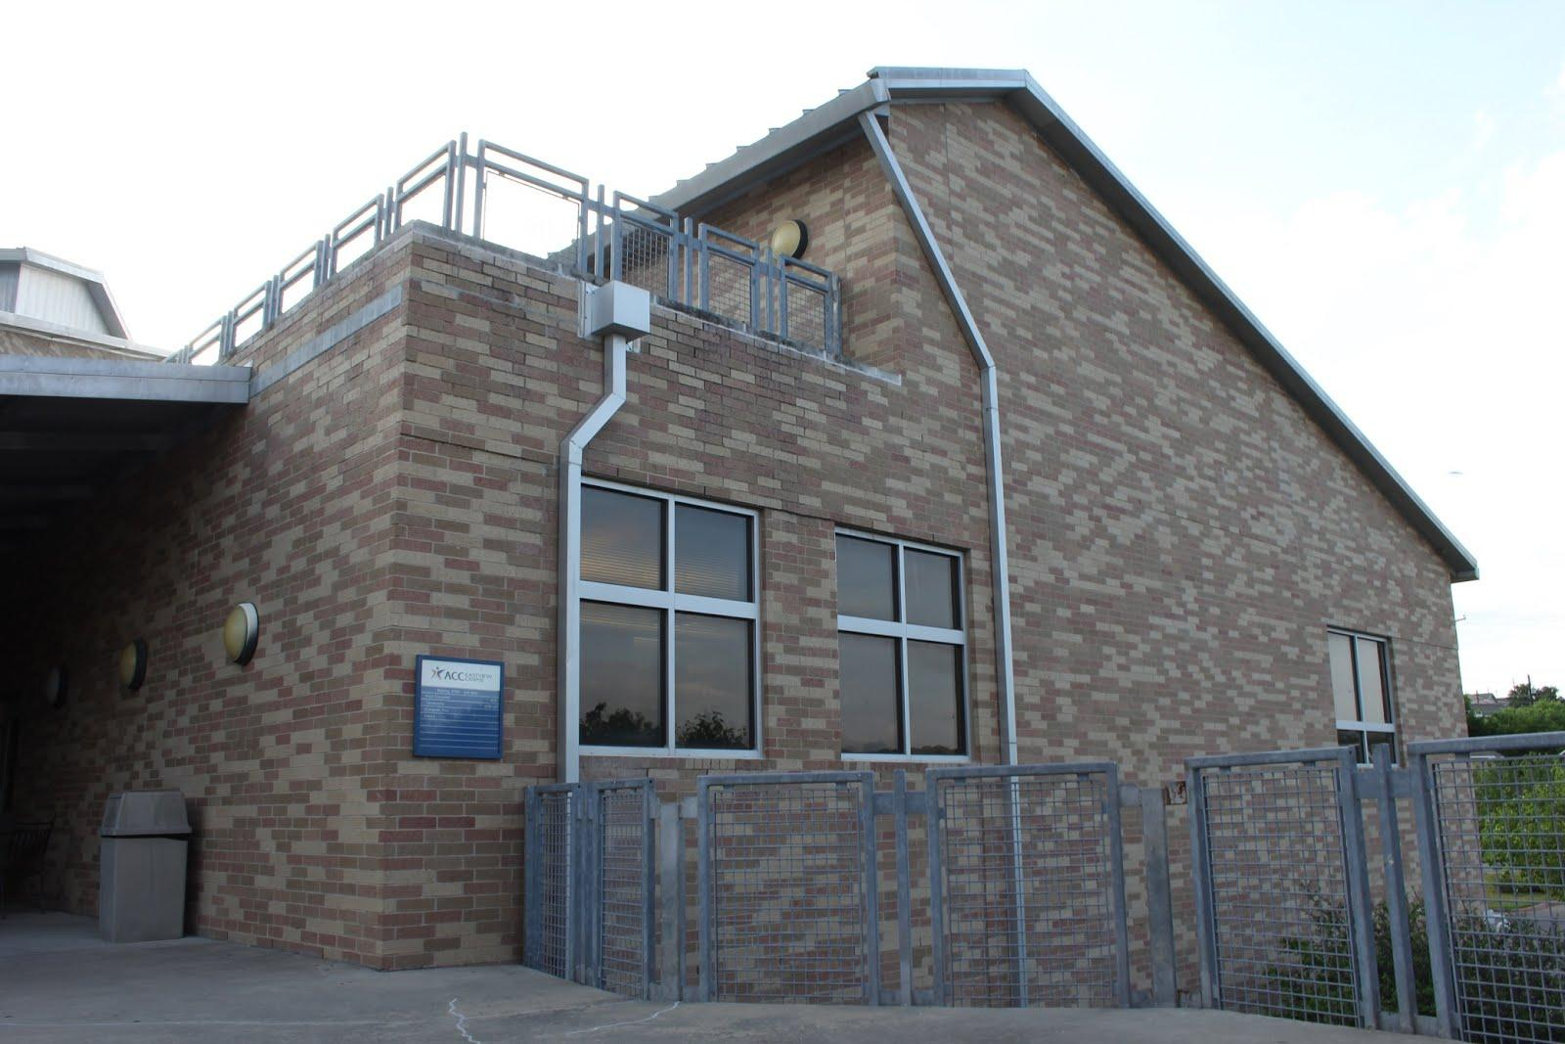
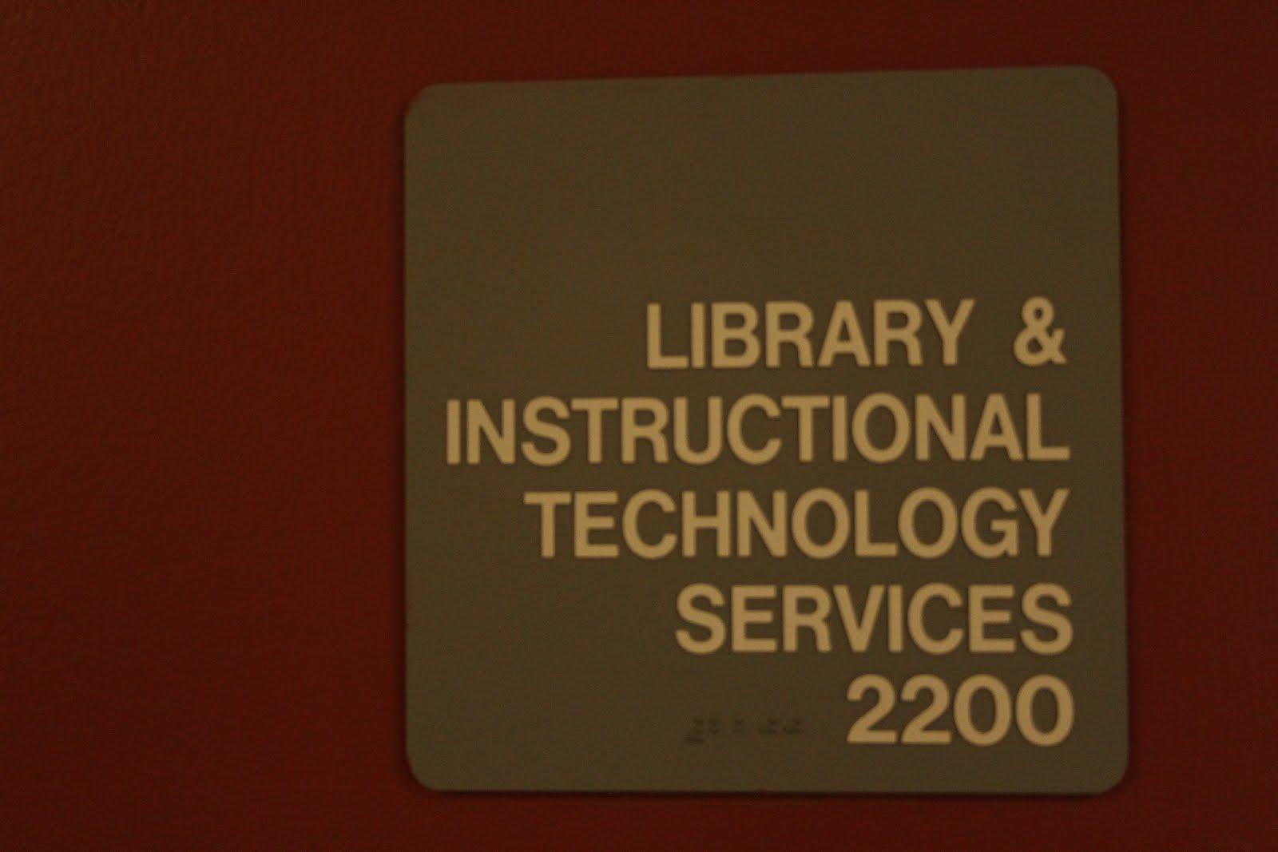
Library: Exterior

Slide 4
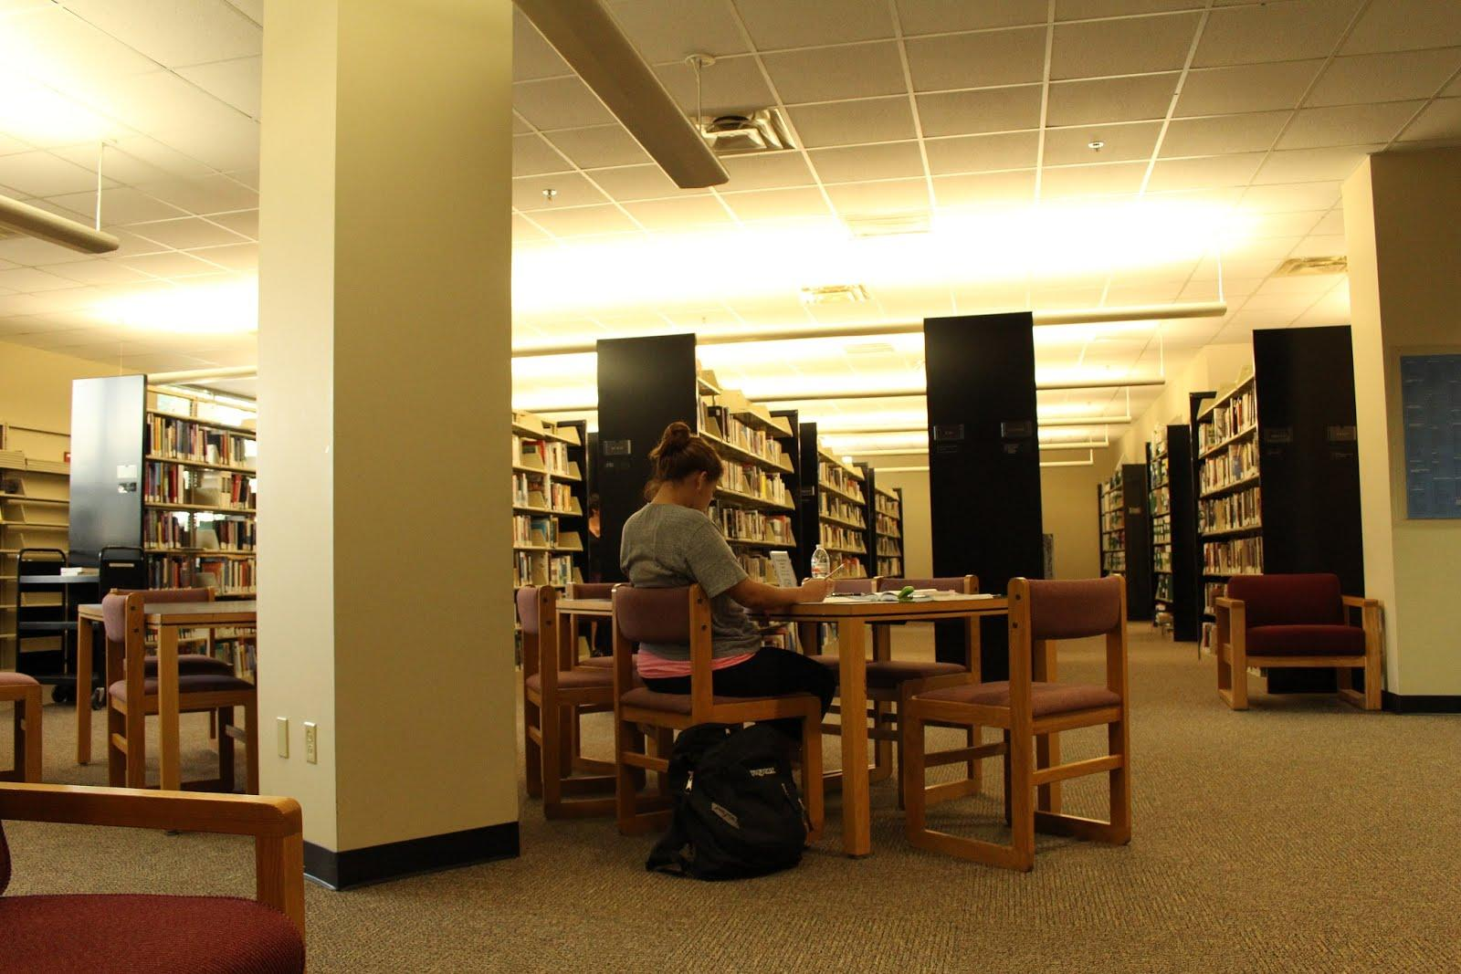
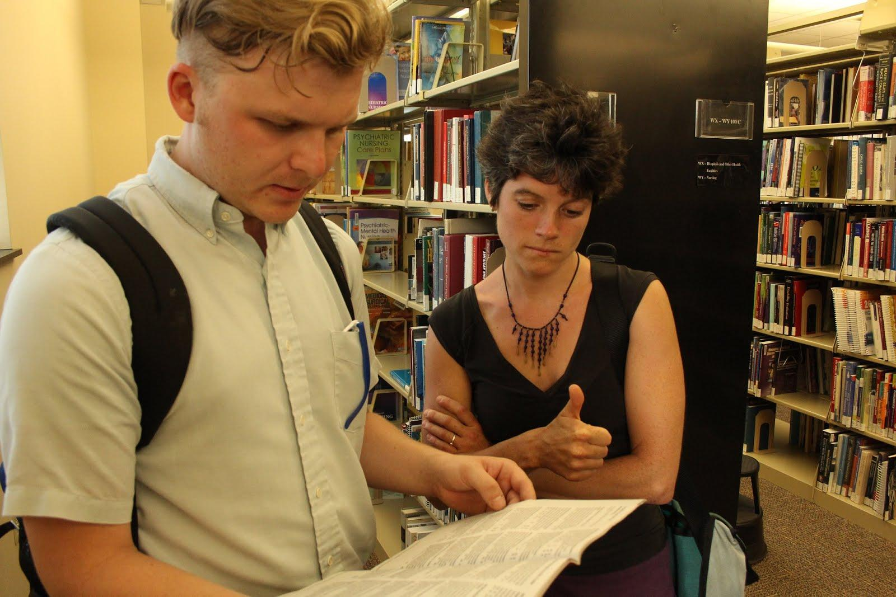
Context: Library Users’ Needs

Slide 5
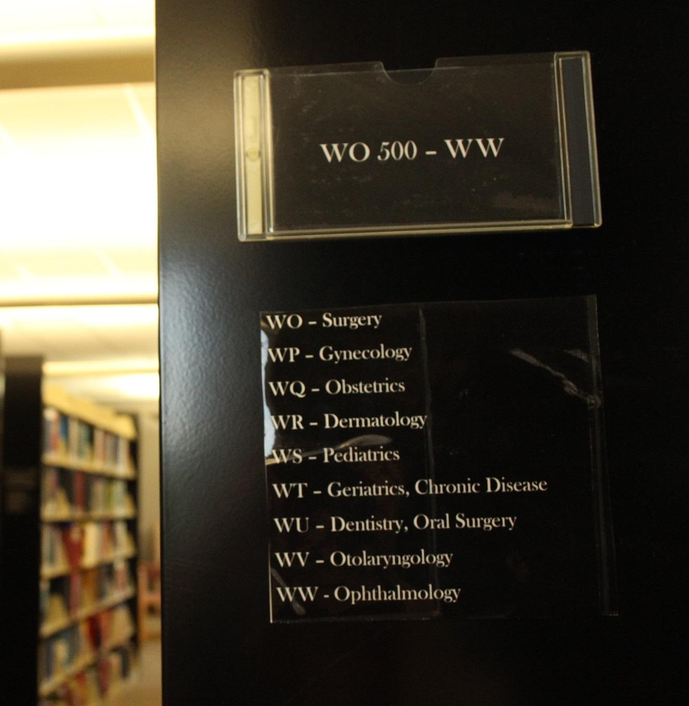
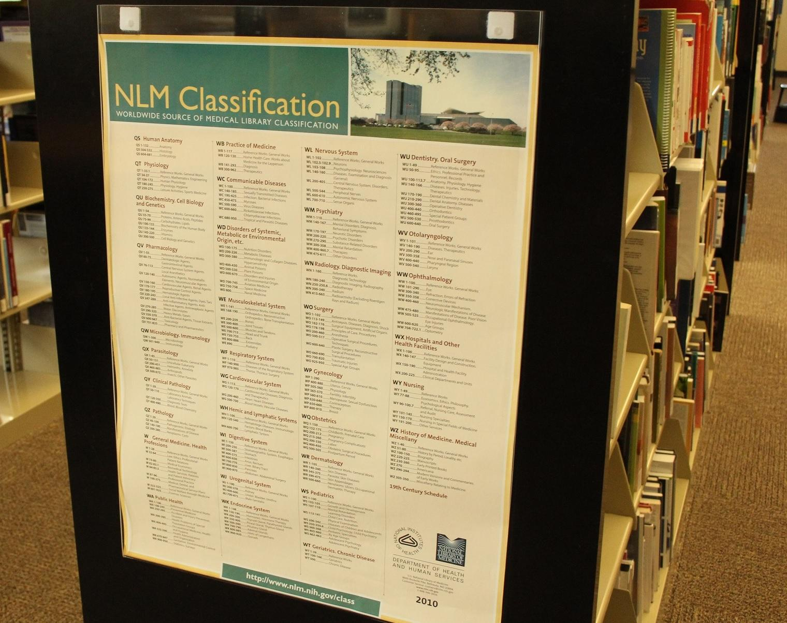
Demographics: ACC Eastview Students

Slide 6
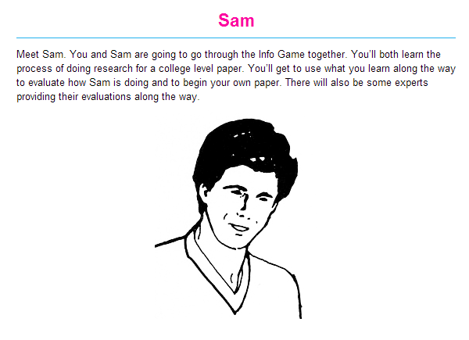

Info Game

Slide 7
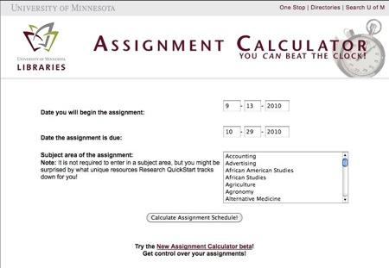
Literature Review: Ground Zero

Slide 8
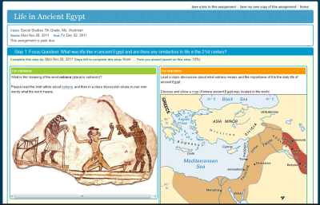
Minitex - Research Project Calculator

Slide 9
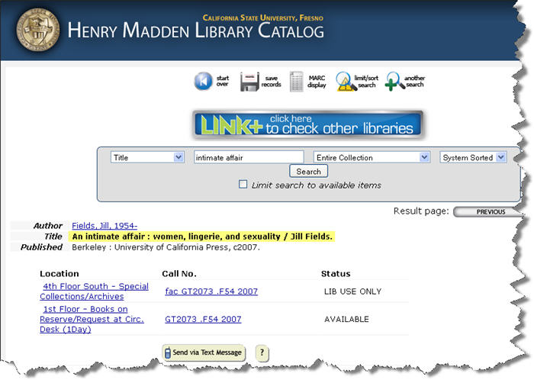
Henry Madden Library - Fresno State

Slide 10
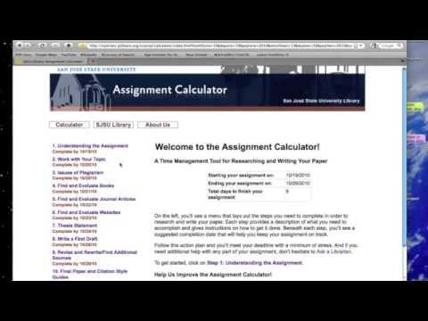
San Jose State University

Slide 11
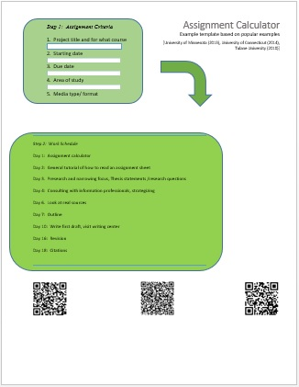
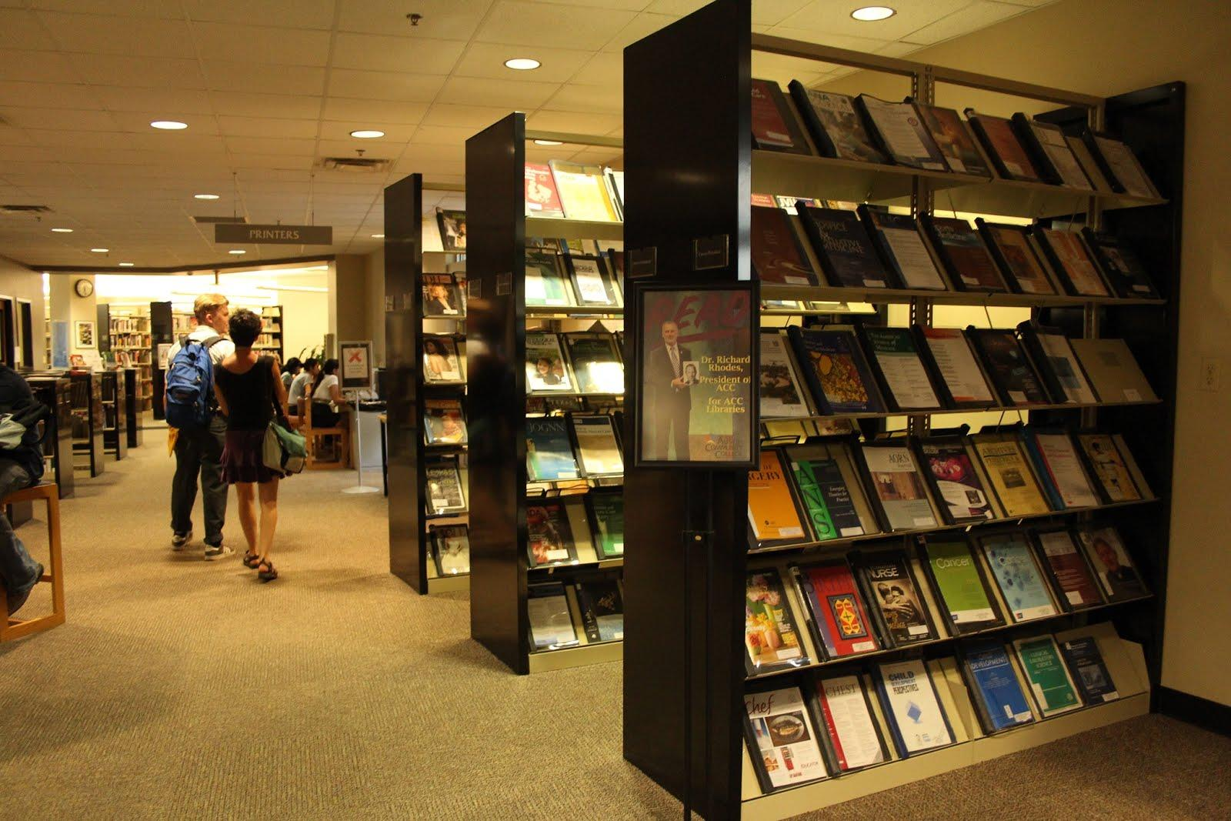
Proposal: Assignment Calculator

Slide 12
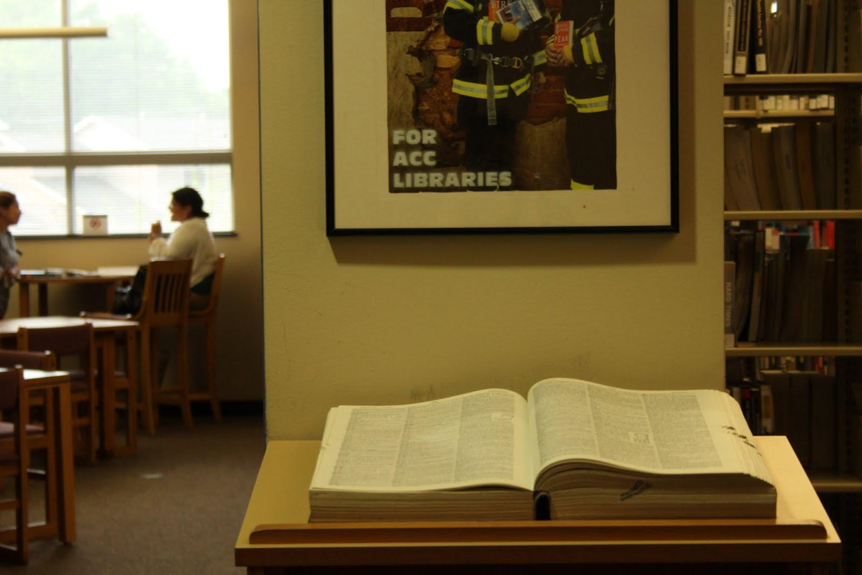
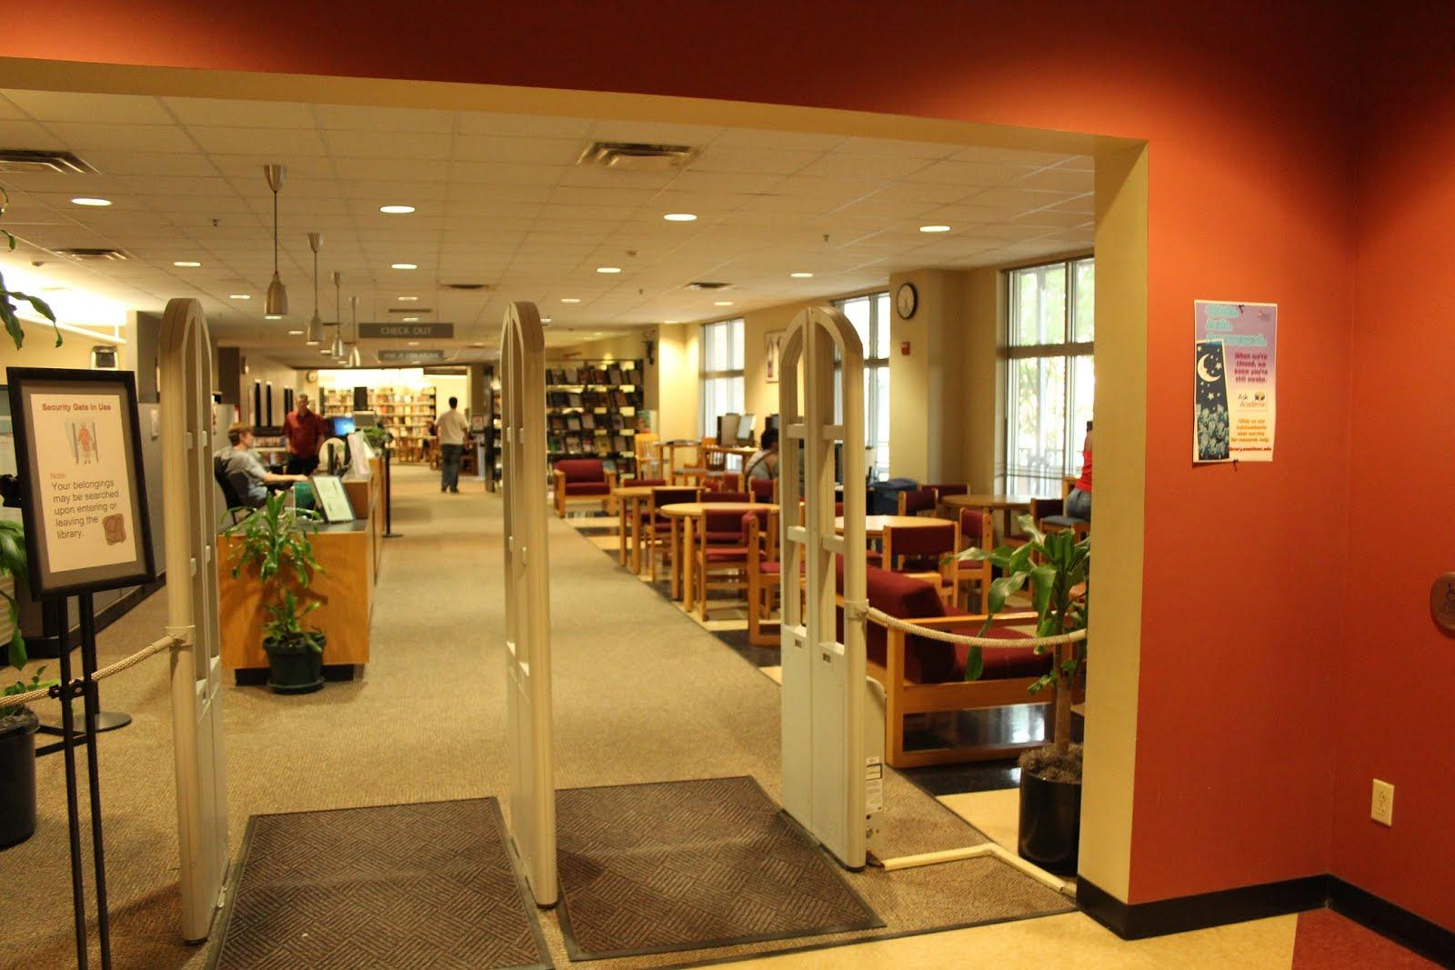
Implementation: Four Benefits

Slide 13
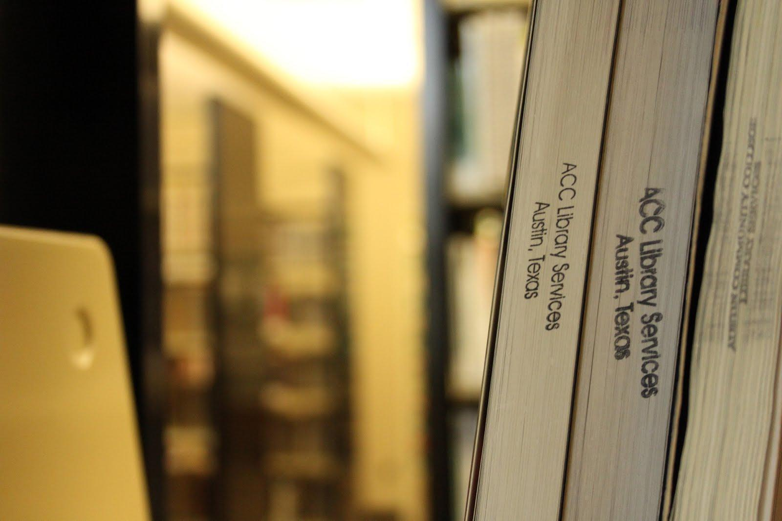
Assessment

Slide 14
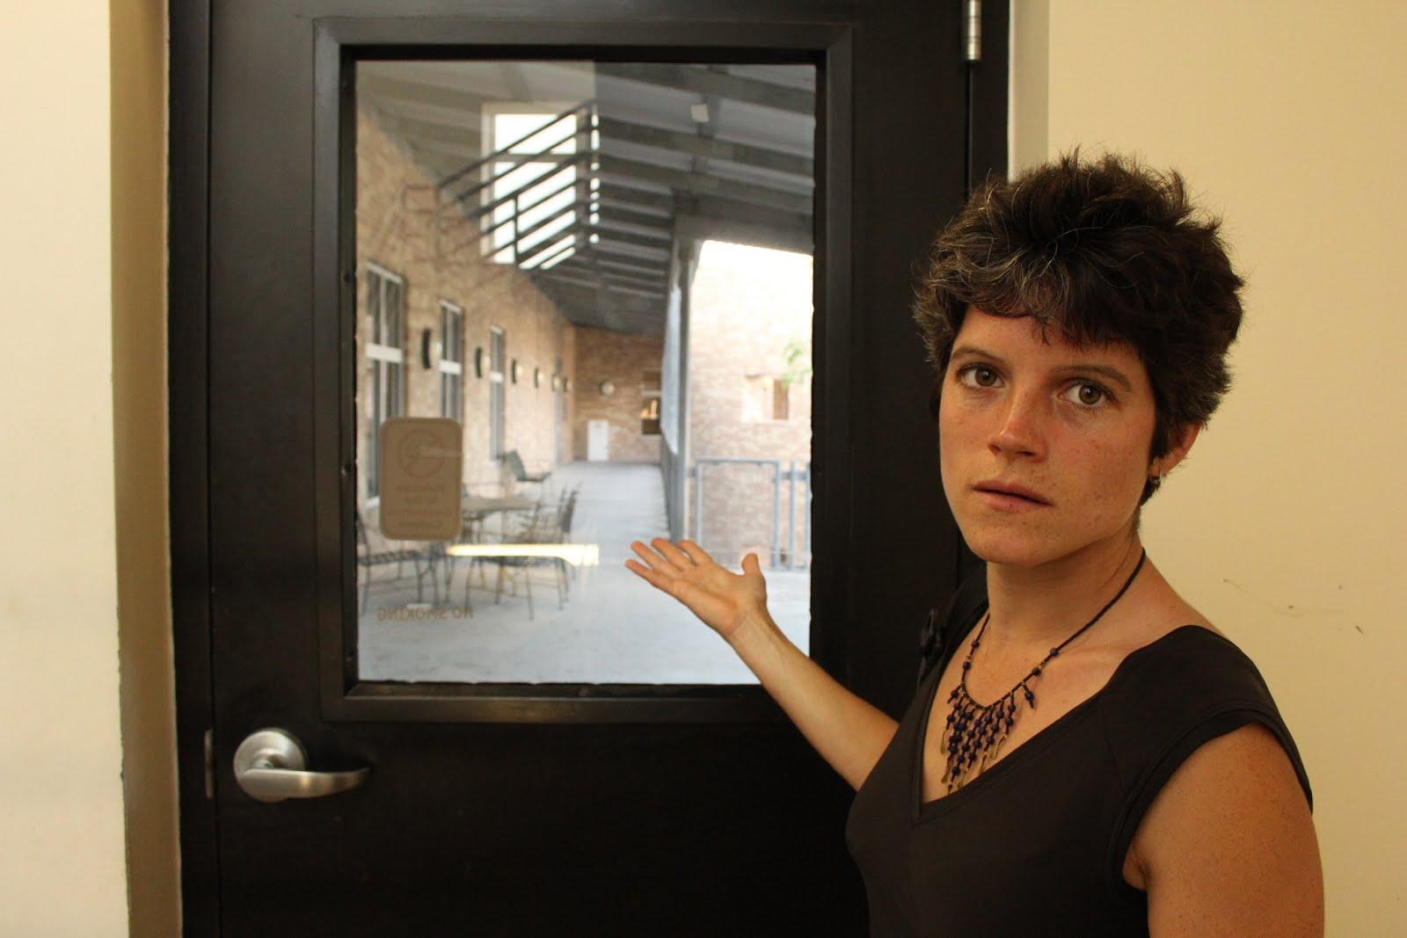
Thank you for visiting Eastview with us!

Slide 15
References
Burhanna, K. J. & Seeholzer, J. (2009). No natives here: A focus group study of student perceptions of web 2.0 and the academic library. The Journal
of Academic Librarianship, 35(6), 523-532.
Davis, B. G. (2009). Tools for Teaching. San Francisco, CA : Jossey-Bass.
Fusich, M. (2009). Assignment research calculator: Designing and implementing a customized product to reach your students. College & Research
Libraries News, 70(8), 456-468.
Henry Madden Library (2012). Assignment Research Calculator. Retrieved from http://ios.lib.csufresno.edu/arc/
Library Services, Austin Community College. (2013). Info Game. Online Tutorials. Retrieved from
http://library.austincc.edu/help/infogamedevelopment/
Magee, J. & Thomas, E. (2010). Customizing an open-source tool to enhance information literacy. New Library World, 11(11/12), 503-512.
Minitex. (2014) Research Project Calculator. Retrieved from https://rpc.elm4you.org/
Regents of the University of Minnesota. (2014). Assignment Calculator. Retrieved from https://www.lib.umn.edu/apps/ac/
San Jose State University (2014). Assignment Calculator: A Time Management Tool for Researching and Writing Your Paper. Retrieved from
http://tutorials.sjlibrary.org/tutorial/calculator/

