Slide 1
PRIMO Site: Evaluating Information
Presented by Katrin Abel & Karl T. Baine
March 9, 2015

Slide 2

Attention!
Is dihydrogen monoxide lethal?
Did Abraham Lincoln file a patent for a Facebook precursor?
Is there a species of octopus that lives in trees?
How many websites are created each minute?

Slide 3
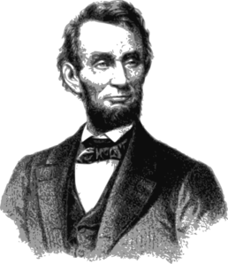
Focus Questions
How can you tell whether information is credible?
How and why does this tutorial work?

Slide 4

Structure
Attention
Overview
Preparation
Exploration
Discussion

Slide 5
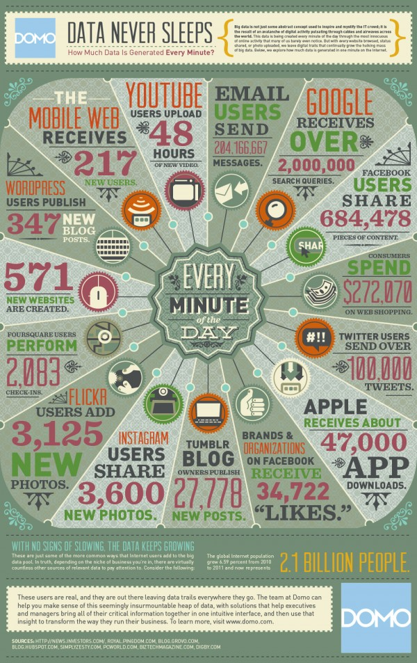
Overview
Erica DeFrain
University of Vermont
Freshman English composition courses
One of six literacy topics
Guide on the Side (GotS) technology
Examines credibility of online sources
Notes:
Pre-search, finding sources, databases, Academic search premier, catalog/ discovery tool

Slide 6
Preparation
Assemble into four groups, by suit.
Briefly read and discuss your question.
Conduct three minutes of Internet research.
Note the credibility of your sources and your level of confidence in your results.
Notes:
Who found a credible source? Who found a non-credible source? Assign a percentage of confidence in your results.

Slide 7

Exploration - Evaluating Information
What do you know?
How do you know?
How can you be sure?
Analyze, evaluate, build confidence

Slide 8

Discussion
Feedback
Handout
Site assessment
Notes:
What have you learned about evaluating information? What are the strengths and weaknesses of the site? Would you use this tutorial, either as-is or modified? If modified, how?

Slide 9
References
“About Guide on the Side.” Arizona Board of Regents. Last modified 2015.
http://code.library.arizona.edu/gots/.
“April 2014 PRIMO Site of the Month.” American Library Association. Last modified 2015.
http://www.ala.org/acrl/aboutacrl/directoryofleadership/sections/is/iswebsite/projpubs/
primo/site/2014april.
Chicago Manual of Style. 16th ed. Chicago, IL: University of Chicago Press, 2010.
DeFrain, Erica. “Evaluating Information.” University of Vermont. Last modified 2013.
http://library.uvm.edu/guide_on_the_side/tutorial/evaluating-information.
“Gagné’s 9 Events of Instruction.” University of Florida. Last modified February 20, 2015.
http://citt.ufl.edu/tools/gagnes-9-events-of-instruction/.

