Slide 1
Tiny Houses:
Resources for Reference
By: Kate Abel and Allyssa Guzman
July 29, 2014

Slide 2
Top Five Resources
1. Tiny House Directory
2. Tumbleweed DIY Book of Backyard Sheds & Tiny Houses
3. GreenFILE
4. Access World News
5. Avery Index to Architectural Periodicals

Slide 3
Context
We are Jane Q. Public, a successful Austin everywoman. We have had the high life and are ready to live more simply and sustainably. We have heard that tiny houses are all the rage and are eager to learn more.

Slide 4

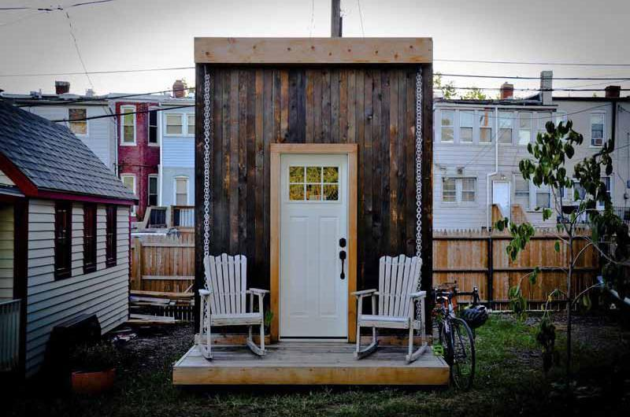
Goal

Slide 5
Questions
1. Where can I find information about tiny houses?
2. What is a good architecture database, and how do I use it?

Slide 6
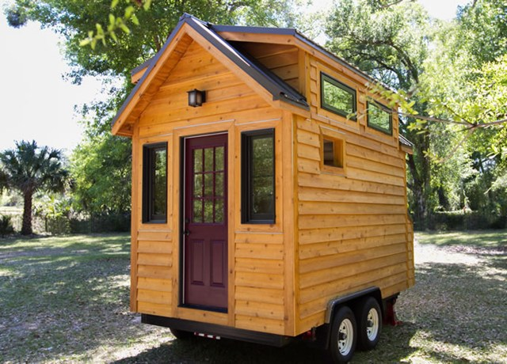
Tiny House Directory
Websites
Books
Plans
Workshops
Builders
Houses

Slide 7

Tumbleweed DIY Book of Backyard Sheds & Tiny Houses
History
Philosophy
Plans
Portfolio
Construction guides

Slide 8
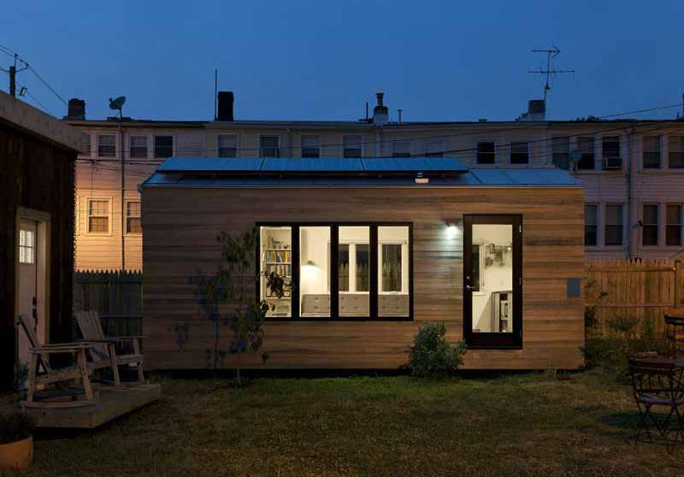
GreenFILE (EBSCO)
Scholarly and general interest
Human/ environmental interaction
Sustainability, global warming, green agriculture, renewable resources
Available through TexShare
"Tiny Houses, Tiny Neighborhoods."

Slide 9
Access World News
Coverage from 1980s to present
Includes newspapers, blogs, journals, transcripts and more
“A tiny, perfect home - It’s cosy, it’s cheap, and it’s portable”
Tiny Home App - Design, Budget, Estimate

Slide 10
Avery Index to Architectural Periodicals
From Columbia University via ProQuest
2,000+ periodicals related to architecture
Covers from 1741 (selective) and 1934 (full)
Scholarly and popular
Weekly updates
Not available through TexShare
"The Tiny House Movement, Under 1,000 Square Feet."

Slide 11
Bibliography
Access World News. NewsBank, 2014. Accessed July 26, 2014.
http://infoweb.newsbank.com/iw-search/we/InfoWeb?p_product=AWNB&p_action=explore&p_theme=aggre
ated5&p_nbid=Q5FW4BXDMTQwNjQ5NzczMS41OTM3NzI6MToxNDoxMjguODMuMjA1LjI0Mg&p_clear_search=yes&
_refprod=NEWSARCHIVES&f_clearContext=yes.
Avery Index to Architectural Periodicals. ProQuest LLC, 2014. Accessed July 25, 2014.
http://search.proquest.com/avery?accountid=7118.
GreenFILE. EBSCO Industries, Inc., 2014. Accessed July 26, 2014.
http://www.austinlibrary.com:2117/ehost/search/advanced?sid=1d10589e-2f68-44db-a5a2-badfb8f4156f%40se
sionmgr113&vid=1&hid=119.
Inside Wealth. "Mansion Tax Collection Reaches Record $289 Million." CNBC LLC, 2014. Accessed July 27, 2014.
http://www.cnbc.com/id/101500804.
Shafer, Jay. Tumbleweed DIY Book of Backyard Sheds & Tiny Houses: Build Your Own Guest Cottage, Writing Studio,
Home Office, Craft Workshop, or Personal Retreat. East Petersburg, PA: Fox Chapel Publishing Company, Inc., 2012.
Tiny House Directory. Tiny Home Builders, 2013. Accessed July 25, 2014. http://www.tinyhousedirectory.com/.

Slide 12
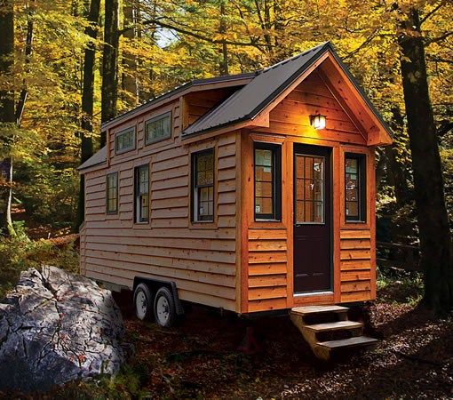
The Winner!

