Slide 1
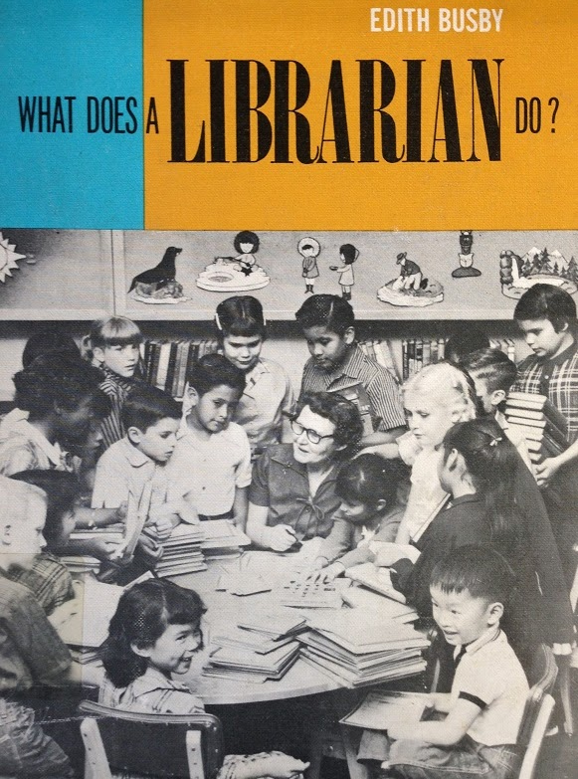
Sensational Informational!
By Kate Abel and Katie Thomas

Slide 2
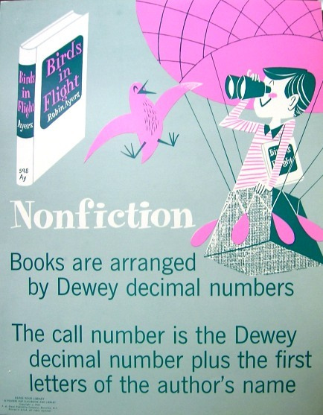
NF, How Dewey Love You?
Acquire information and Understand the world
Make connections between our lives and learning
Introduce scientific method, and vocabulary
Encourages self reliance
Fosters critical reading and thinking skills
Celebrates curiosity
FUN!

Slide 3
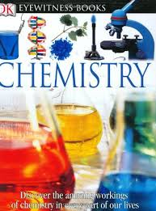

Elements of Info Books
1. Accurate facts
2. Clarifying illustrations
3. Analytical thinking
4. Organization that aids understanding
5. Style that stimulates interest
6. Absence of stereotypes
Now rate your info book!

Slide 4
Evaluation
Is the author qualified?
Are facts and theory clearly distinguished?
Are significant facts provided?
Are differing views on controversial subjects presented?
Is the information free of anthropomorphism, sexism and racism?
Are the illustrations accurate?
Are organizational aids included?
Your book?

Slide 5
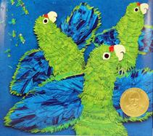
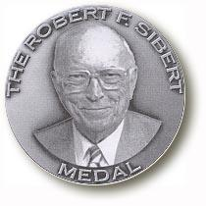
Robert F. Sibert Award
Association for Library Service to Children
Annual ALA Award in honor of
Bound to Stay Bound Books, Inc. President
Given to authors and illustrators of the most notable informational
books for children published in English in the previous year
Since 2001
Only books published in the US by US citizens are eligible

Slide 6
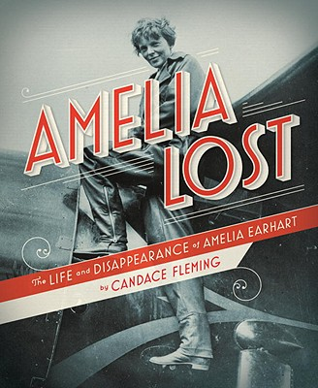
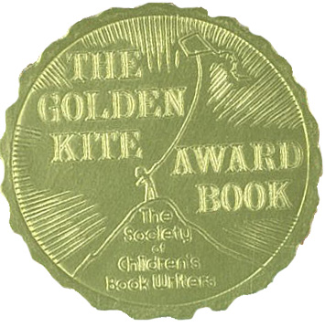
Golden Kite Award
Society of Children’s Book Writers and Illustrators
1 winner and 1 honor book since 1973
Recognizes Nonfiction as one of four categories
  Nonfiction, Fiction, Picture Book Text, Picture Book Illustration
Judged by peers

Slide 7

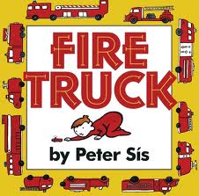
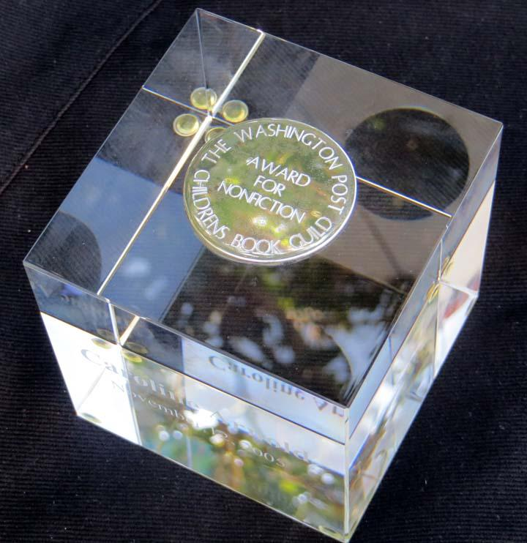
Washington Post -
Childrens Book Guild Award
Given to an author or illustrator for a body of work
Eligible once per decade
Coincides with Children’s Book Week

Slide 8
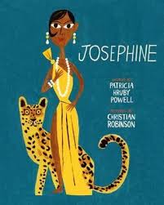
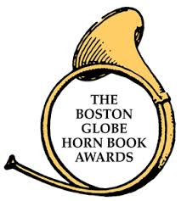
Boston Globe -
Horn Book Award
One winner and two honors annually
Given to four genres
  Fiction, Nonfiction, Picture Book, Poetry

Slide 9
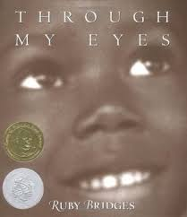

Orbis Pictus Award
National Council of Teachers of English
1 winner and up to 5 honor books annually since 1989
Named after the book considered to be the first picture book for children
Orbis Pictus - The World in Pictures by Czech educator
John Amos Comenius
Example

Slide 10
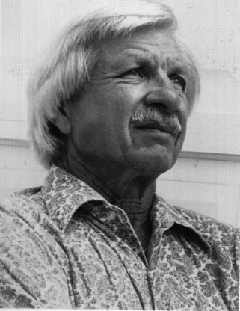
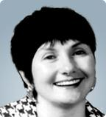
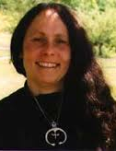
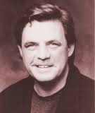
Noteworthy Authors
Lee Ames - Draw 50
Franklyn Branley - Gravity is a Mystery
Joanna Cole - Magic School Bus series
Russell Freedman - The Life and Death of Crazy Horse
Jean Fritz - You Want Women to Vote, Lizzie Stanton?
Gail Gibbons - The Vegetables We Eat
James Cross Giblin - When Plague Strikes: The Black Death, Smallpox, AIDS
Jim Murphy - The Great Fire
Peter Sís - The Wall

Slide 11
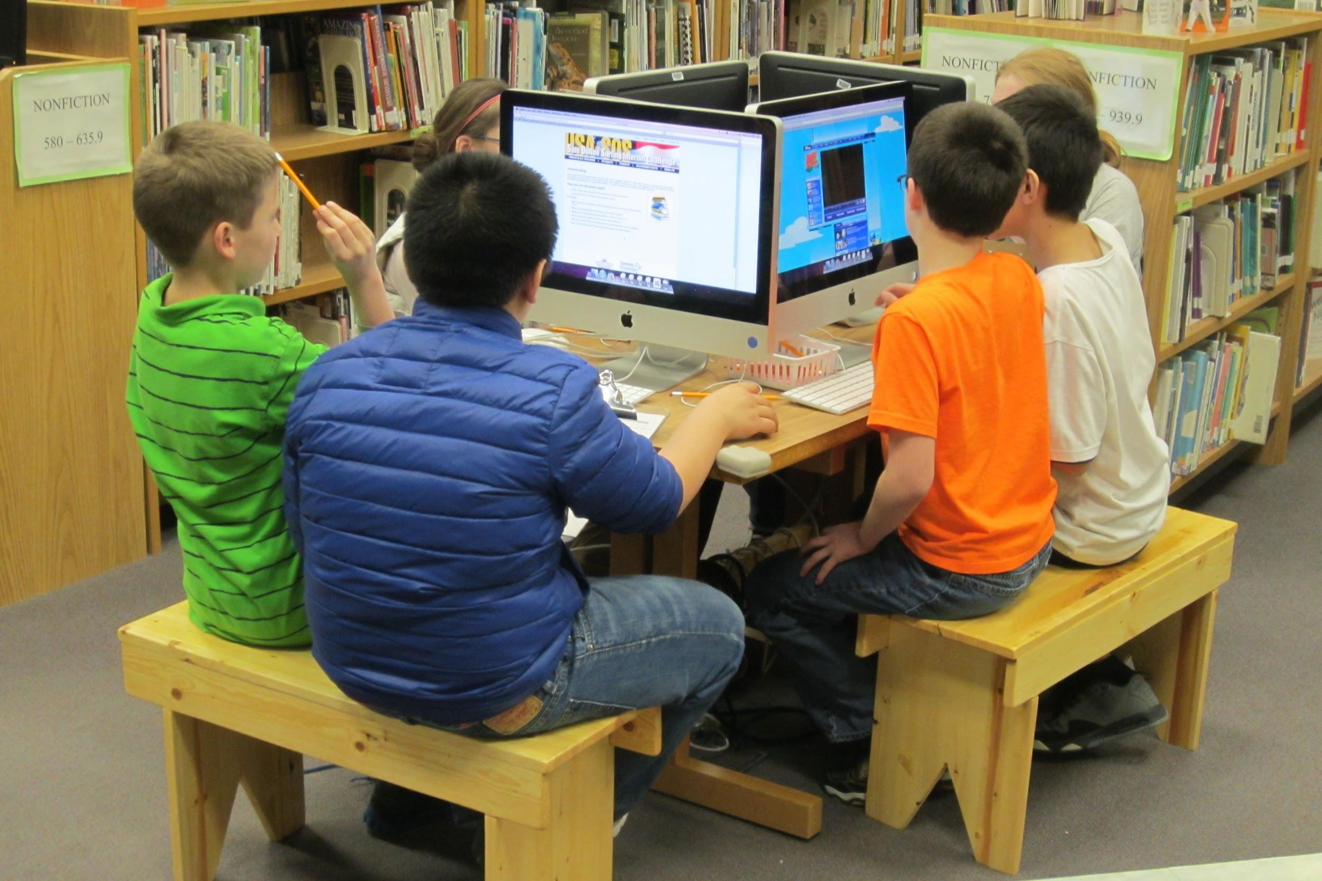

Digital Reference
School Library Journal Picks
Sparticl
Early World of Learning (World Book Online)
Science News for Students
Young Entomologists Society
Back-of-Book recommendations
NASA’s Imagine the Universe! Explore stars,
dark matter, quasars, black holes and more!
Rainforest Alliance Kids' Corner Facts, activities,
e-books and apps for young scientists and
common core-aligned curricula for teachers

Slide 12
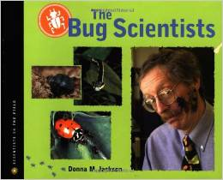
Bring-Your-Own-Book Club
New twist on classic book club
Instead of reading the same book,
each member reads a different one.
Members present the books they read.
Listeners ask about the books.
Members have a chance to explore
each other’s books.
Librarian offers more or less guidance
as needed.

Slide 13
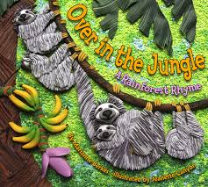
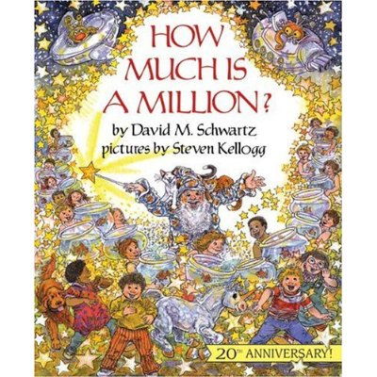
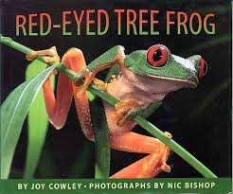
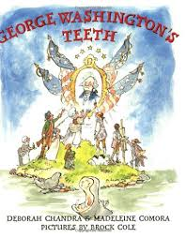
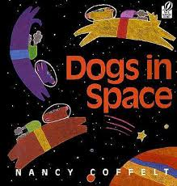
Great Read Alouds
Check Out:
Storytimekatie.com

Slide 14
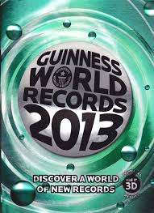
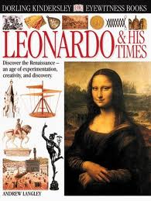
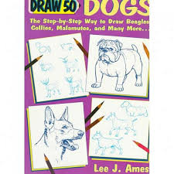
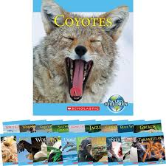
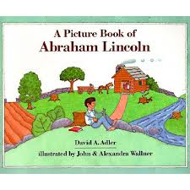
Student Favorites

Slide 15
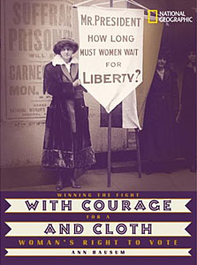
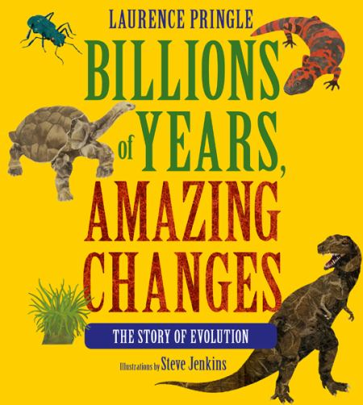
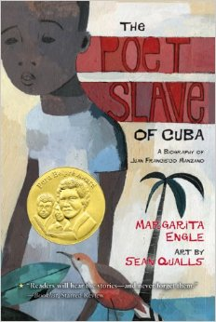

Issues
Shortage of history books for children - Belief that they won’t sell or circulate well, difficult to write for young audiences.
Shortage of qualified authors - More degrees in humanities than science-related fields. Few science-related professions.
Shortage of multicultural authors and topics - Often represented a western, Eurocentric perspective. Today more variety in perspective and topic and more culturally diverse authors: Margarita Engle, Russell Freedman, Laban Carrick Hill, and Kadir Nelson.
Appropriate presentation of controversial subjects - Evolution, European conquest, slavery, apartheid, the Holocaust, civil rights, women’s rights, immigration

Slide 16
Information Overload! A
You will work in two teams. Choose a name that has something to do with information or books or your sparkling intelligence.
Peruse the selection of informational books. What ages are they best for? What kinds of information do they contain? How would you respond to them as a child? How would you use them as a teacher or librarian?
Choose one of the informational books and create a trivia question for the other team to answer. Write your question on your question card.
On the numerically corresponding answer card, write the answer to your question, along with the page number and title of the book where you found the information.
When your team has five completed index cards (10 questions), buzz in.

Slide 17
Information Overload! B
The first team to buzz scores two bonus points. (-2 points for premature buzzing!)
Keep your answer cards, but trade question cards with the other team.
Using the informational books, each person will answer two of the other team’s trivia questions.
When your team has ten complete trivia answers, buzz in. The first team to buzz scores two bonus points. (-2 points for premature buzzing!)
Teams receive one point for each question answered correctly. The team that scores the most points wins! The team that scores the second-most points also wins...just not quite as much.

Slide 18
Sample Question Card
Q1: What do you call the outer boundary of a black hole?
Q2: What kind of insect do forensic entomologists use to determine a body’s time of death?

Slide 19
Sample Answer Card
A1: The Event Horizon
(A Black Hole is Not a Hole, p. 16)
A2: The Blowfly
(The Bug Scientists, p. 29)

Slide 20
Handy Resources for You!
Exploring Environmental Science with Children and Teens
By Eileen G. Harrington, 2014
Resources and programming ideas for both entertaining and educating children of all ages and their families in the area of environmental science. Includes book lists, activity plans, scientific background information, and alignment with the Common Core State Standards.
Nonfiction Matters
By Stephanie Harvey, 1998
Reference book for teaching nonfiction, conducting research, and improving writing skills for grades 3-8. Provides thamatic bibliographies, and curriculum guides.

Slide 21
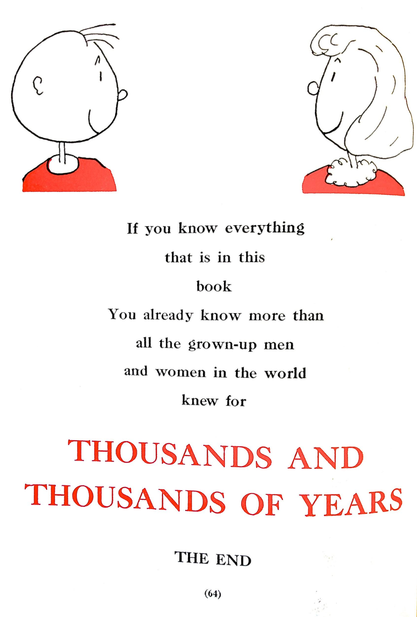
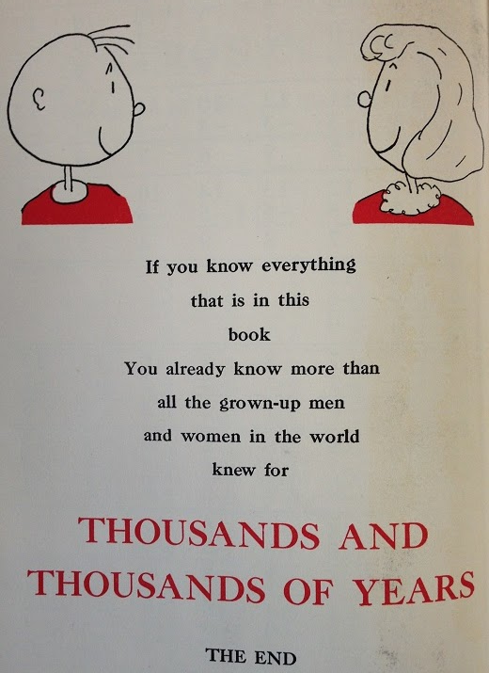

Slide 22
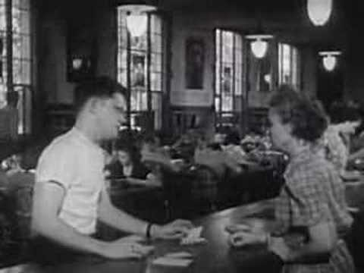
Notes:
As extra, in case we have time. Play intro and forward to 5:07.

